Slide 1
THE HUMAN BIOLOGICAL CLOCK ,
THE CONCEPT OF HOMEOSTASIS
& PHYSIOLOGY OF AGEING
KOFI OWUSU-DAAKU
THURSDAY JUNE 15 & 22 2023

Slide 2
GENERAL OBJECTIVES
OBJECTIVE I
Regulation mechanisms: Principle and operation
Global knowledge of the characteristics and regulation mechanisms in the biological and social systems ( for instance “feedback”, “feed forward” “gain” and interior environment and homeostasis)
OBJECTIVE II
Biological variation (rhythms and cycles):
Global knowledge of the characteristics and cyclical (rhythms) variations in the biological and social systems. To be able to explain the consequences of these cycles observing the variation starting from the individual’s description with referential, biological and psychic parameters . To be able to explain the principles of circadian cycle with real examples

Slide 3
KEY CONCEPT
Homeostasis: All body systems working together to maintain a stable internal environment
Systems respond to external and internal changes to function within a normal range (body temperature, fluid balance)

Slide 4
KEY CONCEPT
Homeostasis is a state of equilibrium:
  opposing forces are in balance
Physiological systems work to restore balance
Failure results in disease or death

Slide 5
KEY CONCEPT
Failure to function within a normal range results in disease
Disease appears to accelerate with age

Slide 6
Maintaining Normal Limits
Receptor:
  receives the stimulus
Control center:
  processes the signal and sends instructions
Effector:
  carries out instructions

Slide 7
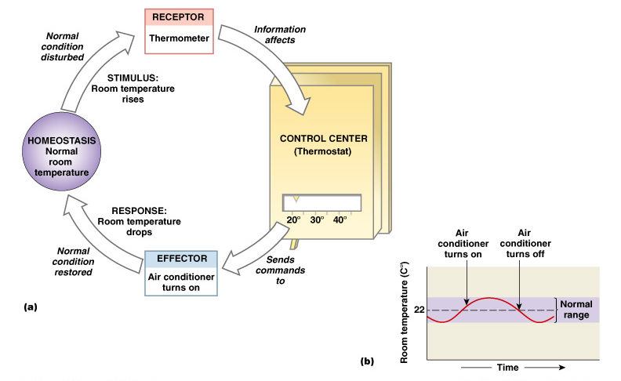
Maintaining Normal Limits
Figure 1–3

Slide 8
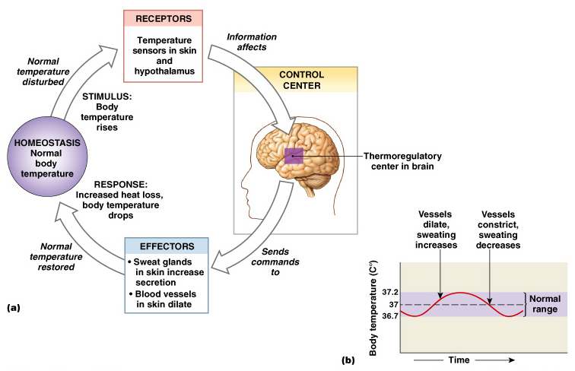
Negative Feedback
The response of the effector negates the stimulus
Figure 1–4

Slide 9
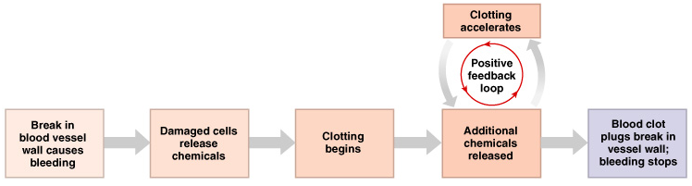
Positive Feedback
The response of the effector reinforces the stimulus
Figure 1–5

Slide 10
Mechanisms of Regulation
Autoregulation (intrinsic):
  automatic response in a cell, tissue, or organ
Extrinsic regulation:
  responses controlled by nervous and endocrine systems

Slide 11
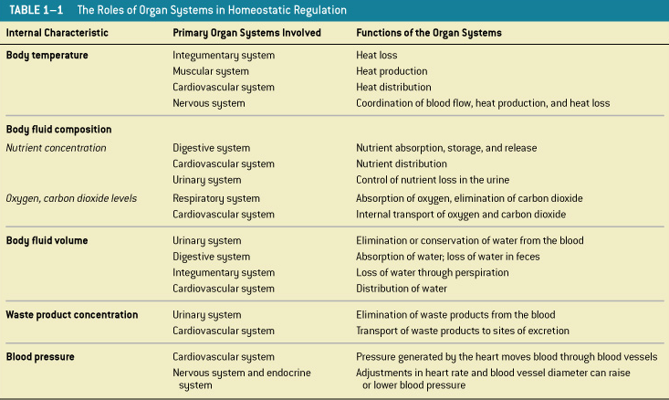
The body systems working together in homeostasis

Slide 12
SPECIFIC LECTURE OBJECTIVES
The Human Biological clock
Internal mechanisms of time
Control of reproductive cycles
Control of other animal behavioural cycles
Jet-lag and shift work as an example of a disrupted cycle

Slide 13
LINKAGES TO THE LECTURE
Sleep as an adaptive response
Sleep as a restorative process
The functions of REM sleep
Physiological mechanisms of sleep and waking – chemical and neural controls
Sleep disorders
Altered states of consciousness

Slide 14
Review 1
Sleep serves as an adaptive response providing a period of restoration
Sleep slow wave sleep appears to be most important phase permitting the brain to recuperate as brain metabolism is lowered
REM sleep is less understood but it is believed to promote brain development and learning. Its absence is not fatal compared to slow wave sleep

Slide 15
SLEEP
Normal cycle
Disorders
Dreams

Slide 16
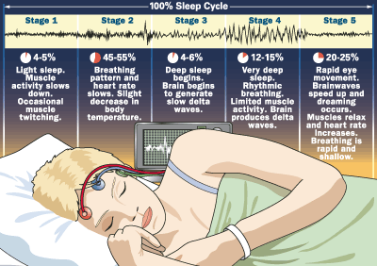

Slide 17
Stage
EEG Rate
(Frequency)
EEG Size
(Amplitude)
Awake
8-25 Hz
Low
α/ β
1
6-8 Hz
Low
α/ θ
2
4-7 Hz
Occasional "sleep spindles"
Occasional "K" complexes
Medium
θ
3
1-3 Hz
High
δ
4
Less than 2 Hz
High
δ
REM
More than 10 Hz
Low
θ(teta)

Slide 18
TWO STATES OF SLEEP
NREM- non-rapid eye movement and has 4 stages- An idling brain in a movable body
REM- Rapid eye movement a single stage- an awake brain in a paralysed body
the two types alternate through out the sleep period

Slide 19
Characteristics of NREM
Slowing of EEG rhythm
Higher muscle tone
Absence of eye movement
Absence of ‘thought-like’ mental activity
The deepest sleep levels occur in stages 3 & 4 and occurs first half of the night referred to as delta sleep and duration of delta is 65% inherited. Most adults spend sleep time in stage 2 and least in stage 1

Slide 20
Characteristics of REM
An aroused EEG pattern
Sexual arousal
Rapid eye movement
Elaborate visual imaging (dreaming)
Associated with pons
Occurs during the last half of the night gets progressively longer as the night wears on.
Occurs in a 90 minutes cycle

Slide 21
Further (REM) activities
Changes in blood pressure and respiratory rate
Less receptive to outside stimuli than in deep sleep
Muscle tone decreases markedly
Intense inhibition of somatic motor neurons
Sleep latency Period between trying to fall asleep and sleep onset. Insomniacs have long sleep latencies. REM latency: Period between falling asleep until first REM about 90 minutes

Slide 22

Imagine
It’s dark
No sounds, except for an owl
People are asleep

Slide 23
Sleep patterns & age
Neonate 16-18 hrs 50% REM
1 yr 12 hrs 30% REM
10yrs 10hrs 25%
13 -16 8hrs 20%
Adults gradual drops further
decrease after 80yrs
ZZZZZZzzzzzzzzzzzZZZZZzzzzZZZZZZZ

Slide 24
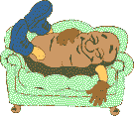
How much sleep is needed?
Premature infants no pattern
Adult-like rhythm established after 1 yr. neonatal cycle 30-40 minutes and gradually lengthens to 90 min cycle in teens.
Adults initial REM cycle 90 min approx and gets progressively shorter across evening. Sleep time decreases with age.
In elderly sleep time continues to decline. stage 3 deltalsleep vanishes..do not feel rested as before

Slide 25

In general.....
Children need more sleep than elderly
Up to 50% is spent in REM sleep therefore children dream most
Elderly have less slow wave sleep, so less deep sleep, so they wake up more easily during sleep

Slide 26
What are the characteristics of brain activity associated with the different levels of sleep?

Slide 27
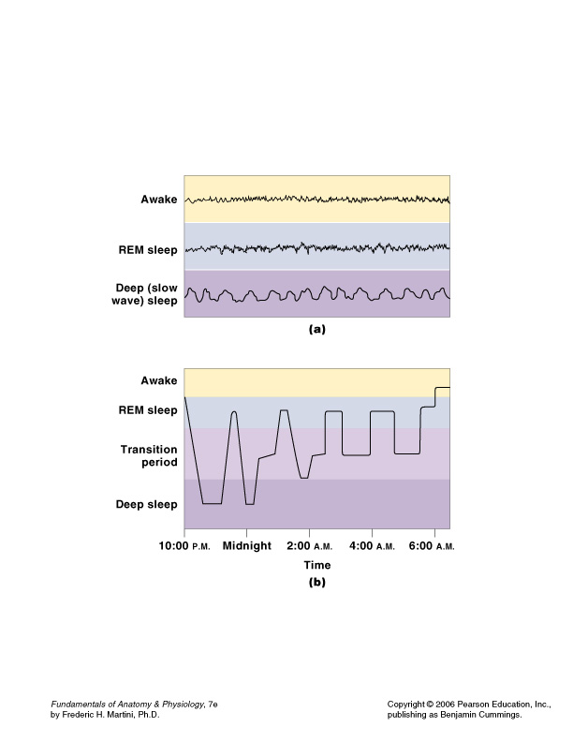
2 Levels of Sleep
Characteristic patterns of brain wave activity
  deep sleep- part of NREM
  REM

Slide 28
Deep Sleep
Also called slow wave sleep
Entire body relaxes
Cerebral cortex activity minimal
Heart rate, blood pressure, respiratory rate, and energy utilization decline up to 30%

Slide 29
Nighttime Sleep Pattern
Alternate between levels
Begin in deep sleep
REM periods average 5 minutes in length; increase to 20 minute over 8 hours

Slide 30
Nighttime Sleep Pattern

Slide 31
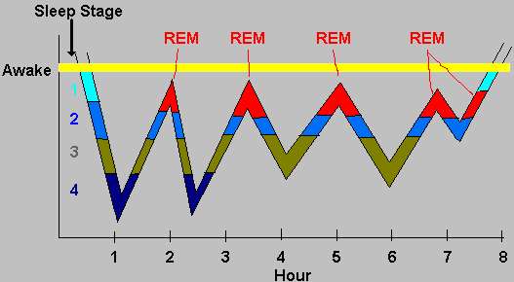

Slide 32
Significance of Sleep
Has important impact on CNS
Minor changes in physiological activities of organs and systems
Protein synthesis in neurons increases during sleep
Extended periods without sleep lead to disturbances in mental function

Slide 33
Arousal
Awakening from sleep
Function of reticular formation

Slide 34
Reticular Formation
Extensive interconnections with sensory, motor, integrative nuclei, and pathways along brain stem

Slide 35
State of Consciousness
Determined by complex interactions between reticular formation and cerebral cortex

Slide 36
Reticular Activating
System (RAS)
Important brain stem component
Diffuse network in reticular formation
Extends from medulla oblongata to mesencephalon

Slide 37
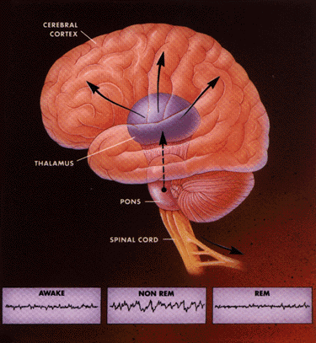

Slide 38
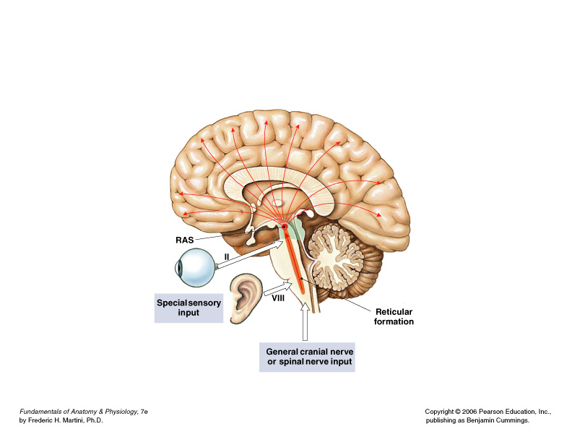
Reticular Activating
System (RAS)

Slide 39
RAS and Cerebral Cortex
Output of RAS projects to thalamic nuclei that influence large areas of cerebral cortex
When RAS inactive, so is cerebral cortex
Stimulation of RAS produces widespread activation of cerebral cortex

Slide 40
Mesencephalic Portion of RAS
“Headquarters” of system
Stimulation of area produces most pronounced and long-lasting effects on cerebral cortex
Greater stimulation leads to more alert and attentive induvidual

Slide 41
Thalamic Nuclei
Important role in focusing attention on specific mental processes

Slide 42
Ending Sleep
Any stimulus activates reticular formation and RAS
Arousal occurs rapidly
Effects of single stimulation of RAS last less than a minute

Slide 43
Maintaining Consciousness
By positive feedback:
  activity in cerebral cortex, basal nuclei, and sensory and motor pathways continue to stimulate RAS

Slide 44
Maintaining Consciousness
After many hours, reticular formation becomes less responsive to stimulation
Individual becomes less alert and more lethargic
Neural fatigue reduces RAS activity

Slide 45
Regulation of
Awake–Asleep Cycles
Involves interplay between brain stem nuclei that use different neurotransmitters
Group of nuclei stimulates RAS with NE and maintains awake, alert state
Other group promotes deep sleep by depressing RAS activity with serotonin
“Dueling” nuclei located in brain stem

Slide 46
Brain waves types
The level of electrical activity of cortex depends on degree of wakefullness .
What kind of waves predominate when an adult is awake and relaxed (with closed eyes)? α waves (f = 10 HZ, a = 50 μV)

Slide 47
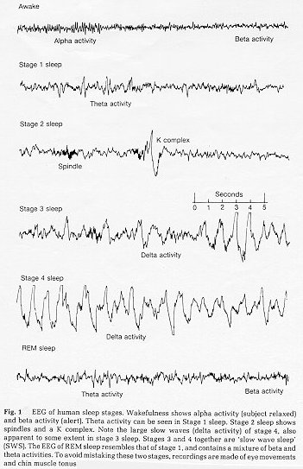

Slide 48
When do β waves (f = 20 Hz) appear?
When the eyes are opened, other sensory organs are stimulated, or the person solves a maths problem. The amplitude of these waves is lower,and are mainly found in occipital and parietal regions. (As well appears during arousal activity)

Slide 49
And γ and θ and δ waves?
γ waves during learning activities
θ waves appear when drowsiness descends to sleep
δ waves are slow waves during sleep

Slide 50
What is the function of sleep?
Form a group and decide in 5 minutes why this is the most important function of sleep
One person of the group will explain to the group in 1 minute

Slide 51
KEY CONCEPT
An individual’s state of consciousness is variable and complex
Ranges from energized and “hyper” to unconscious and comatose

Slide 52
KEY CONCEPT
During deep sleep, all metabolic functions are significantly reduced
During REM sleep, muscular activities are inhibited while cerebral activity is similar to that seen in awake individuals

Slide 53
REVIEW 2
Sleep is generally regarded as a steady state; nevertheless it is a behaviour
The sleep cycle can be monitored by EEG. REM and non REM alternate in a 90 minute cycle
Alertness consist of desynchronised beta activity
Relaxation and drowsiness consist of alpha activity
4 stages of Non-REM sleep
Stage 1 sleep - alpha and irregular
Stage 2 sleep – spindle and ocassional K complex
Stage 3 sleep – up to 50 % delta
Stage 4 sleep more than 50% delta
REM sleep
Rapid eye movement desynchronised EEG activity, sensitivity to external stimulation, muscular paralysis, genital activity and day dreaming

Slide 54
REVIEW 3
Cyclic regulation of sleep suggest there are sleep promoting substances produced during wakefulness and wakeful promoting substances produced during sleep adenosine serves as a link increased brain metabolism and the necessity of sleep
Four nuclei in the brain appear to be active during wakefulness forming part of the RAS complex i) acetylcholinergic system peribrachial area of pons and the basal forebrain ii) adrenergic system of the coeruleus iii)serotgenic system of the raphe nuclei iv) histamigenic system og the tuberomamillary nucleus
Non –REM sleep occurs when ventrolateral preoptic area becomes active inhibiting the nuclei prompting wakefulness.
REM sleep occurs when the activity of acetyl cholinergic neurons in the prebrachial area increases to activate those in thalamus and the basal forebrain. These neurons produce rapid eye movement in connection with motor neurons in the tectum.
REM sleep is inhibited by nor adrenergic and serotonic neuronsof the raphe nuclei

Slide 55
REVIEW 4
SLEEP DISORDERS
25% of adult population experiences sleep disorders
Insomnia- Recurring problems of falling or staying asleep
Narcolepsy- a sleep disorder characterized by uncontrollable sleep attacks. The sufferer may lapse directly into REM sleep often at inopportune times
Sleep apnea - a sleep disorder characterized by temporary cessations of breathing during sleep and consequent momentary awakenings
Night terrors – Sleep disorder characterized by high arousal and an appearance of being terrified distinguished from nightmares (occurs in early morning REM )in the fact that they occur at stage 4 of cycle 2-3hrs after falling asleep

Slide 56
Forms of Narcolepsy
Sleep attack- An irresistible urge to sleep during the day ; after which the person wakes feeling refreshed.
Cataplexy- A complete paralysis that occurs in a subject when awake over relaxation of muscles as would occur during REM triggered by extreme excitement
Sleep apnea - a sleep disorder characterized by temporary cessations of breathing during sleep and consequent momentary awakenings
Night terrors – Sleep disorder characterized by high arousal and an appearance of being terrified distinguished from nightmares (occurs in early morning REM )in the fact that they occur at stage 4 of cycle 2-3hrs after falling asleep

Slide 57
CIRCADIAN & BIOLOGICAL RHYTHMS
Periodic physiological fluctuation in the workings of our bodies attuned to the mind. They tend to be cyclical
90-minute cycle (sleep)
24 hour cycle (Circadian)
28-day – menstrual cycles and PMT/PMS
Annual – seasonal affective disorder

Slide 58
CIRCADAN RHYTHMS & ZEITGEBERS
Circadian rhythms refer to daily rhythmic changes in behaviour or physiological processes lasting about 25hrs.
Some of these rhythms are passive responses to changes in illumination but most are controlled by internal clocks which are re-set every 24 hours.
The stimulus that resets the internal biological clock is the zeitgeber (time giver) such as dawn which synchronises endogenous rhythm

Slide 59
SUPRACHIASMATIC NUCLEUS (SCN) & CIRCADIAN RHYTHMS
SCN is a nucleus situated atop the optic chiasm in the hypothalamus. It contains the primary biological clock responsible for organising most of the body’s circadian rhythms.
Melanopsin is a photo pigment produced by a gene on chromosme 10 and found in the cells of the retina appaears to be the detector of light that serves as the zetigeber.
SCN controls drinking eating and sleeping cycles

Slide 60
OPERATION OF SCN
Individual neurons rather than circuits are responsible for the ticking of the internal clocks. Synchronisation of the firing of these neurons is achieved therough chemical communication. Two genes dicovered in drosophila but also found in rodents tim and per inhibit further protein synthesis until they disintegrate to kick start the cycle again.

Slide 61
28-DAY cycle and PMS
Women tend to be more depressed, tense and irritable during the 2-3 days before her period.
Research, however, shows women’s mood did not vary significantly across their menstrual cycle. Their perceived or recalled mood tend to be worse than their actual. A woman’s feel of tension just before or during her period is more likely to be associated with premenstural tension (PMT) than a similar situation during the inter menstrual period.
Neverthelss there is a recognition of premenstrual syndrome (PMS) where some women experience lethargy, sadness irritability, headaches, insomnia, sleepiness disinterest or heightened interest in sex. PMS varies with culture

Slide 62
SEASONAL RHYTHMS
Though SCN is known to have an intrinsic rhythm of 24hours it is known to play a role in much longer rhythms. So that it is involved in a biological calendar as well as a biological clock.
Experiments with hamsters show increase in the secretion of testosterone to kick start the breeding season as day light lengthens. Lesions in the SCN abolishes the cycle so the rodents produce testosterone all year

Slide 63
PINEAL GLAND AND MELATONIN IN SEASONAL RHYTHMS
The pineal gland is attached to the dorsal surface of the tectum in the midbrain.
It produces melatonin which is a hormone so named because it has the ability to darken the skin.
The neurons in the SCN make synaptic connections with neurons in the paraventricular neurons PVN of the hypothalamus and axons make connection thru post ganglionic neurons of the sympathetic nervous system with pineal gland causing it to secrete large amounts of melatonin priming the body for the long darkness of winter

Slide 64
ANNUAL CYCLES SEASONAL AFFECTIVE DISORDER
Annual cycles will cause animals to migrate, hibernate breed etc.
In humans annual cycles will cause variation in appetite, sleep length and moods. In some people there is a clinical depression in the long winter months which is defined as seasonal affective disorder. The depression lifts thru spring and summer

Slide 65
Seasonal affective disorder (SAD)
Depressive symptoms during winter months
Winter has shortest days/least amount of light
"Atypical" symptoms:
Increased sleep
Increased appetite
Decreased energy
Caused by abnormal melatonin metabolism
Treat with bright light therapy (not melatonin tablets)

Slide 66
CHANGES IN CIRCADIAN RHYTHM
When people abruptly change their daily rhythms of activity, their internal circadian rhythms controlled by SCN become desynchronised with those of the external environment e.g. shift workers and those who travel across time zones and experience jet lag.
This disparity between internal rhythms and and the external environment results in sleep disturbances and mood change \nd interferes with one’s ability yo function during waking hours

Slide 67
CHANGES IN CIRCADIAN RHYTHM-JET LAG
Jet lag is a temporary phenomenon and after a few days of readjustment people experiencing jet lag fall asleep at the appropriate time and their day time alertness improves

Slide 68
CHANGES IN CIRCADIAN RHYTHM- SHIFT WORK
Shift work presents a more enduring problem when people are required to change shift frequently and therefore poses a greater impact on mood and health

Slide 69
MITIGATING THE EFFECT OF CHANGES IN CIRCADIAN RHYTHM
The aim is to get the internal clocks to synchronize with the external environment as quickly as possible by providing strong zeitgebers at the appropriate time. Increase artificial light at their low point at night shift and darken their rooms during rest.
It is known melatonin is secreted more in the night particularly around one’s bedtime. Appropriate administration of Melatonin significantly reduces the effect of jet lag and shift work.. It does improve the sleep of blind people for whom light cannot act as zeitgeber

Slide 71
Ageing & Geriatrics
Medical specialty dealing with problems associated with aging
Trained physicians, or geriatricians

Slide 72
LECTURE OBJECTIVE
Concept of homeostasis, disease and ageing
The patho-physiological changes of organs and systems, their functional consequences and the preventive aspects linked to physiology
Changes that affect the organs and systems when ageing including reference to age-related specific diseases

Slide 73
11 organ systems of the human body 1
Integumentary – Skin & accessories- protection, sensation tem regulation
Skeletal- bones & cartilages – support and protection, calcium reserve blood cell formation
Muscular- skeletal muscles and associated tendons- movement, protection, support, generates heat to maintain body temp.
Nervous – CNS, PNS, sense organs – immediate response to stimuli, coordinates activity of organ systems, interprets sensory information
Endocrine – endocrine glands and tissues – directs long-term changes in metabolism controls structural and functional changes in development such as puberty, ageing
Cardiovascular – Heart, Blood & vessels – Distribution and exchange of materials round the body

Slide 74
11 organ systems of the human body 2
Lymphatic – spleen, thymus, lymphatic nodes and vessels, tonsils – defence and returning fluid to blood stream
Respiratory – nasal cavity, sinuses, respiratory tracts and lungs – gas exchange – sounds & communication
Digestive - GIT and associated structures , salivary, liver, and pancreas –processing digestion and absorption of food
Urinary – kidneys, ureters urinary bladder, urethra – waste products, water balance, electrolyte balance
Reproductive – testes, penis glands and tracts; ovaries womb, vagina, ducts and mammary glands – male gametes, hormones, female gametes hormones, milk

Slide 75
Effect of Ageing on Homeostasis

Slide 76
Ageing and Tissue Structure
Speed and efficiency of tissue repair decreases with age, due to:
  slower rate of energy consumption (metabolism)
  hormonal alterations
  reduced physical activity

Slide 77
Effects of Ageing
Chemical and structural tissue changes:
  thinning epithelia and connective tissues
  increased bruising and bone brittleness
  joint pain and broken bones
  cardiovascular disease
  mental deterioration

Slide 78
Ageing and Cancer
Cancer rates increase with age:
Death from cancer would invariably increase with age
Heredity, diet, environmental chemicals and cigarette smoke may pre-dispose one to cancer

Slide 79
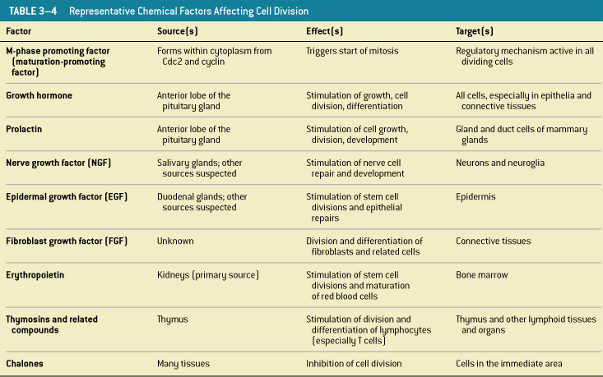
Chemicals Controlling
Cell Division
Table 3–4

Slide 80
Regulating Cell Life
Normally, cell division balances cell loss

Slide 81
Factors Increase Cell Division
Increases cell division:
  internal factors M-phase Promoting Factor (MPF)
  extracellular chemical factors (growth factors)

Slide 82
Factors Decrease Cell Division
Decreases cell division:
  repressor genes (faulty repressors cause cancers)
  worn out telomeres (terminal DNA segments)

Slide 83
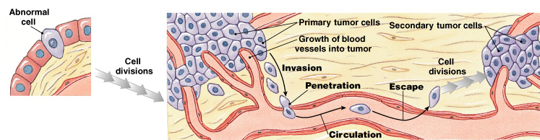
Cancer
Figure 3–26

Slide 84
Cancer Stages
Cancer develops in steps:
  abnormal cell
  primary tumor
  metastasis
  secondary tumor

Slide 85
Cell Division and Tumors
Tumor (neoplasm):
  enlarged mass of cells
  abnormal cell growth and division

Slide 86
Benign Tumors
Benign tumor:
  contained
  not life threatening

Slide 87
Malignant Tumors
Malignant tumor:
  spread into surrounding tissues (invasion)
  start new tumors (metastasis)

Slide 88
Cancer and Cells
Cancer:
  illness that disrupts cellular controls
  produces malignant cells

Slide 89
Cancer and Genes
Oncogenes:
  mutated genes that cause cancer

Slide 90
KEY CONCEPT
Mutations disrupt normal controls over cell growth and division
Cancers often begin where stem cells are dividing rapidly
More chromosome copies mean greater chance of error

Slide 91
Cell Differentiation
Cells specialize or differentiate:
  to form tissues (liver cells, fat cells, and neurons)
  by turning off all genes not needed by that cell

Slide 92
KEY CONCEPT
All body cells, except sex cells, contain the same 46 chromosomes
Differentiation depends on which genes are active and which are inactive

Slide 93
What are the effects of aging on the skin ( integumentary system)?
Organ System 1

Slide 94
Effects of Ageing
Epidermal thinning
Decreased numbers of Langerhans cells
Decreased vitamin D₃ production
Decreased melanocyte activity
Decreased glandular activity (sweat and oil glands)

Slide 95
Effects of Ageing
Reduced blood supply
Decreased function of hair follicles
Reduction of elastic fibers
Decreased hormone levels
Slower repair rate

Slide 96
What are the effects of ageing on the skeletal system?
Organ System 2

Slide 97
Age and Bones
Bones become thinner and weaker with age
Osteopenia begins between ages 30 and 40
Women lose 8% of bone mass per decade, men 3%

Slide 98
Effects of Bone Loss
The epiphyses, vertebrae, and jaws are most affected:
  resulting in fragile limbs
  reduction in height
  tooth loss

Slide 99
Osteoporosis
Severe bone loss
Affects normal function
Over age 45, occurs in:
  29% of women
  18% of men

Slide 100
Hormones and Bone Loss
Estrogens and androgens help maintain bone mass
Bone loss in women accelerates after menopause

Slide 101
Cancer and Bone Loss
Cancerous tissues release osteoclast-activating factor:
  that stimulates osteoclasts
  and produces severe osteoporosis

Slide 102
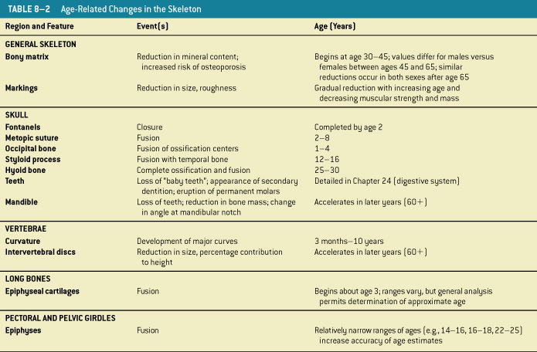
Age-Related Skeletal Changes
Table 8–2

Slide 103
What are the effects of ageing on articulations (between bones), and the most common clinical problems?

Slide 104
Rheumatism
A pain and stiffness of skeletal and muscular systems

Slide 105
Arthritis
All forms of rheumatism that damage articular cartilages of synovial joints

Slide 106
Osteoarthritis
Caused by wear and tear of joint surfaces, or genetic factors affecting collagen formation
Generally in people over age 60

Slide 107
Rheumatoid Arthritis
An inflammatory condition
Caused by infection, allergy, or autoimmune disease
Involves the immune system

Slide 108
Gouty Arthritis
Occurs when crystals (uric acid or calcium salts):
  form within synovial fluid
  due to metabolic disorders

Slide 109
Joint Immobilization
Reduces flow of synovial fluid
Can cause arthritis symptoms
Treated by continuous passive motion (therapy)

Slide 110
Bones and Ageing
Bone mass decreases
Bones weaken
Increases risk of hip fracture, hip dislocation, or pelvic fracture

Slide 111
Effect of Ageing on the Muscular System
Organ System 3

Slide 112
Effects of Ageing on the Muscular System
Skeletal muscle fibers become smaller in diameter
Skeletal muscles become less elastic:
  develop increasing amounts of fibrous tissue (fibrosis)
Decreased tolerance for exercise
Decreased ability to recover from muscular injuries

Slide 113
What are the effects of ageing on the nervous system?
Organ System 4

Slide 114
Ageing on the nervous system
Anatomical and physiological changes begin after maturity (age 30)
Accumulate over time
85% of people over age 65 have changes in mental performance and CNS function

Slide 115
Reduction in Brain Size and Weight
Decrease in volume of cerebral cortex
Narrower gyri and wider sulci
Larger subarachnoid space

Slide 116
Reduction in Number of Neurons
Brain shrinkage linked to loss of cortical neurons
No neuronal loss in brain stem nuclei

Slide 117
Decrease in Blood Flow to Brain
Arteriosclerosis:
  fatty deposits in walls of blood vessels
  reduce blood flow through arteries
  increase chances of rupture
Cerebrovascular accident (CVA), or stroke:
  may damage surrounding neural tissue

Slide 118
Changes in Synaptic
Organization of Brain
Number of dendritic branches, spines, and interconnections decrease
Synaptic connections lost
Rate of neurotransmitter production declines

Slide 119
Intracellular and Extracellular
Changes in CNS Neurons
Neurons in brain accumulate abnormal intracellular deposits
Including lipofuscin and neurofibrillary tangles

Slide 120
Lipofuscin
Granular pigment with no known function

Slide 121
Neurofibrillary Tangles
Masses of neurofibrils form dense mats inside cell body and axon

Slide 122
Plaques
Extracellular accumulations of fibrillar proteins
Surrounded by abnormal dendrites and axons

Slide 123
Plaques and Tangles
Contain deposits of several peptides
Primarily 2 forms of amyloid ß (Aß) protein
Appear in brain regions specifically associated with memory processing

Slide 124
Anatomical Changes
Linked to functional changes
Neural processing becomes less efficient with age
Memory consolidation more difficult
Secondary memories harder to access

Slide 125
Sensory Systems
Hearing, balance, vision, smell, and taste become less acute
Reaction times slowed
Reflexes weaken or disappear

Slide 126
Motor Control
Precision decreases
Takes longer to perform

Slide 127
Incapacitation
85% of elderly population develops changes that do not interfere with abilities
Some individuals become incapacitated by progressive CNS changes

Slide 128
Senility
Also called senile dementia
Degenerative changes:
  memory loss
  anterograde amnesia
  emotional disturbances
Alzheimer’s disease is most common

Slide 129
What are the effects of ageing on the Sense Organs

Slide 130
Cataract
Condition in which lens has lost its transparency

Slide 131
Senile Cataracts
Natural consequence of aging
Most common form of cataracts

Slide 132
GLAUCOMA
Loss of vision as a result of abnormally high pressure build in the eye
Primary chronic glaucoma is age induced

Slide 133
LOSS OF ACOMMODATION
The ability of the ciliary muscles to contract to reduce tension of suspensory ligament making lens to become rounder to focus on near object. In old age ciliary muscles relax need convex lenses to compensate ( presbyopia)

Slide 134
Number of Taste Buds- Gustatory
Begins declining rapidly by age 50

Slide 135
Olfactory Receptor Population- Smelling
Considerable turnover
Number of olfactory receptors declines with age

Slide 136
Hearing Range
From softest to loudest represents trillion fold increase in power
Never use full potential
Young children have greatest range

Slide 137
Balance
The semi-circular canals have an ampulla with gelatinous cupula, hair cells with cilia and the mineral crystals- otolith. The correct movement and close linkage with vestibular-branch of cranial nerve (VIII) ensure balance in a three-dimensional plane . Ageing leads to loss of otoliths cilia from hair cells disrupting balance

Slide 138
Ageing Effects
Tympanic membrane gets less flexible
Articulations between ossicles stiffen
Round window may begin to ossify

Slide 139
What are the effects of hormones of the endocrine system in ageing ?
Organ System 5

Slide 140
Hormone Changes
Can alter intellectual capabilities, memory, learning, and emotional states
Affect behavior when endocrine glands are over secreting or under secreting

Slide 141
Ageing
However, if there are no disorders, hormones are known to cause few functional changes due to ageing
Decline in concentration of:
  growth hormone
  reproductive hormones

Slide 142
What are the effects of ageing on the cardiovascular system?
Organ System 6

Slide 143
Ageing and the
Cardiovascular System
Cardiovascular capabilities decline with age
Age-related changes occur in:
  blood
  heart
  blood vessels

Slide 144
3 Age-Related Changes in Blood
Decreased hematocrit
Blood clots (thrombus)
Blood-pooling in legs
  due to venous valve deterioration

Slide 145
5 Age-Related
Changes in the Heart
Reduced maximum cardiac output
Changes in nodal and conducting cells
Reduced elasticity of fibrous skeleton
Progressive atherosclerosis
Replacement of damaged cardiac muscle cells by scar tissue

Slide 146
3 Age-Related
Changes in Blood Vessels
Arteries become less elastic:
  pressure change can cause aneurysm
Calcium deposits on vessel walls:
  can cause stroke or infarction
Thrombi can form:
  at atherosclerotic plaques

Slide 147
Clinical Patterns
There are many categories of cardiovascular disorders
Disorders may:
  affect all cells and systems
  be structural or functional
  result from disease or trauma

Slide 148
What are the effects of ageing on the lymphatic system and immune response?
Organ System 7

Slide 149
Ageing and the Immune Response
Immune system deteriorates with age, increasing vulnerability to infections and cancer

Slide 150
4 Effects of Ageing on Immune Response
Thymic hormone production:
  greatly reduced
T cells:
  become less responsive to antigens

Slide 151
4 Effects of Ageing on Immune Response
Fewer T cells reduce responsiveness of B cells
Immune surveillance against tumor cells declines

Slide 152
Nervous and Endocrine Systems
Interact with thymic hormones
Adjust sensitivity of immune response

Slide 153
Disorders of the
Lymphatic System
3 categories affect immune response:
  disorders resulting from:
    an insufficient immune response
    an inappropriate immune response
    an excessive immune response

Slide 154
What are the effects of ageing on the Respiratory system?
Organ System 8

Slide 155
3 Effects of Ageing on the Respiratory System
Elastic tissues deteriorate:
  reducing lung compliance
  lowering vital capacity

Slide 156
3 Effects of Ageing on the Respiratory System
Arthritic changes:
  restrict chest movements
  limit respiratory minute volume

Slide 157
3 Effects of Ageing on the Respiratory System
Emphysema:
  affects individuals over age 50
  depending on exposure to respiratory irritants (e.g., cigarette smoke)

Slide 158
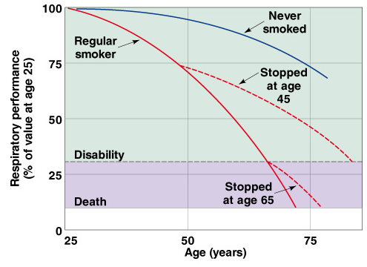
Respiratory
Performance and Age

Slide 159
What are the effects of aging on the digestive system?
Organ System 9

Slide 160
5 Effects of Ageing on the Digestive System
Division of epithelial stem cells declines:
  digestive epithelium becomes more susceptible to damage by abrasion, acids, or enzymes

Slide 161
5 Effects of Ageing on the Digestive System
Smooth muscle tone and general motility decreases:
  peristaltic contractions become weaker

Slide 162
5 Effects of Ageing on the Digestive System
Cumulative damage from toxins (alcohol, other chemicals) absorbed by digestive tract and transported to liver for processing

Slide 163
5 Effects of Ageing on the Digestive System
Rates of colon cancer and stomach cancer rise with age:
  oral and pharyngeal cancers common among elderly smokers

Slide 164
5 Effects of Ageing on the Digestive System
Decline in olfactory and gustatory sensitivities:
  lead to dietary changes that affect entire body

Slide 165
What are the effects of ageing on (URINARY SYSTEM) -fluid, electrolyte, and acid–base balance?
Organ System 10

Slide 166
Age-Related Changes in Urinary System
Decline in number of functional nephrons
Reduction in GFR
Reduced sensitivity to ADH
Problems with micturition reflex

Slide 167
3 Micturition Reflex Problems
Sphincter muscles lose tone:
  leading to incontinence

Slide 168
3 Micturition Reflex Problems
Control of micturition can be lost due to:
  a stroke
  Alzheimer’s disease
  CNS problems affecting cerebral cortex or hypothalamus

Slide 169
3 Micturition Reflex Problems
In males, urinary retention may develop if enlarged prostate gland compresses the urethra and restricts urine flow

Slide 170
Ageing and Fluid Balance (1 of 5)
Body water content, ages 40–60:
  males 55%
  females 47%
After age 60:
  males 50%
  females 45%

Slide 171
Ageing and Fluid Balance (2 of 5)
Decrease body water content reduces dilution of:
  waste products
  toxins
  drugs

Slide 172
Ageing and Fluid Balance (3 of 5)
Reduction in glomerular filtration rate and number of functional nephrons:
  reduces pH regulation by renal compensation
Ability to concentrate urine declines:
  more water is lost in urine

Slide 173
Ageing and Fluid Balance (4 of 5)
Insensible perspiration increases:
  as skin becomes thinner
Maintaining fluid balance:
  requires higher daily water intake

Slide 174
Ageing and Fluid Balance (5 of 5)
Reduction in ADH and aldosterone sensitivity:
  reduces body water conservation
  when losses exceed gains

Slide 175
Ageing and Electrolyte Balance
Muscle mass and skeletal mass decrease:
  cause net loss in body mineral content
Loss is partially compensated by:
  exercise
  dietary mineral supplement

Slide 176
Ageing and Acid–Base Balance
Reduction in vital capacity:
  reduces respiratory compensation
  increases risk of respiratory acidosis
  aggravated by arthritis and emphysema

Slide 177
Ageing and Major Systems
Disorders affecting major systems increase:
  affecting fluid, electrolyte, and/or acid–base balance

Slide 178
What changes in the reproductive system occur with ageing?
Organ System 11

Slide 179
Ageing and the
Reproductive System
Female reproductive system:
  changes associated with menopause
Male reproductive system:
  changes associated with andropause
  occur gradually, over longer time period

Slide 180
Menopause
Is the time that ovulation and menstruation cease
Typically occurs around age 45–55

Slide 181
Perimenopause
Is the interval immediately preceding menopause
Ovarian and uterine cycles become irregular:
  due to shortage of primordial follicles
  estrogen levels decline
  ovulation is not triggered

Slide 182
Premature Menopause
Is depletion of follicles before age 40

Slide 183
Menopause
Circulating concentrations of estrogens and progesterone decline
Production of GnRH, FSH, and LH rises sharply

Slide 184
Decline in Estrogen Levels
Leads to:
  reduction in uterus and breast size
  thinning of urethral and vaginal epithelia
  reduction in bone deposition (osteoporosis)

Slide 185
Andropause (1 of 2)
Also called male climacteric
Is the period of declining reproductive function
Circulating testosterone begins to decline:
  between ages 50 and 60
Circulating FSH and LH increase

Slide 186
Andropause (2 of 2)
Sperm production continues
Sexual activity gradually decreases:
  with declining testosterone levels

Slide 187
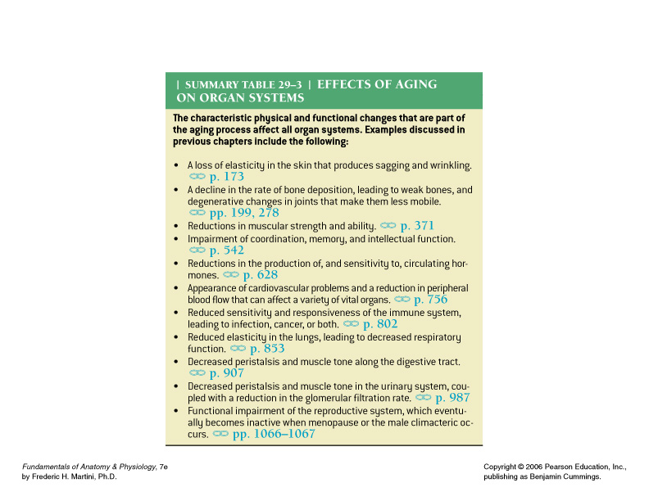
Effects of Ageing on the Organ Systems
Table 29–3

Slide 188
Senescence
Ageing
Reduces functional capabilities of individual
Affect homeostatic mechanisms
Sex hormone levels decline at menopause or male climacteric

